Slide 1
State-Space Planning

Slide 2
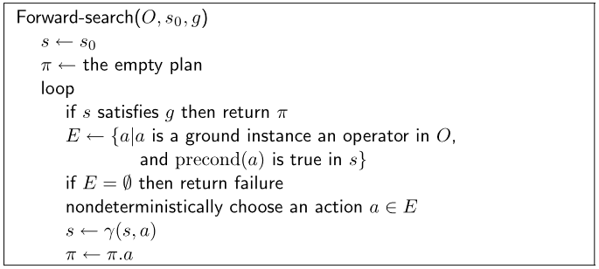
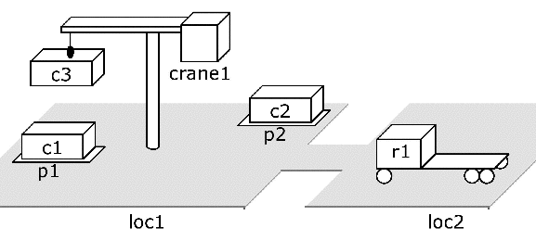
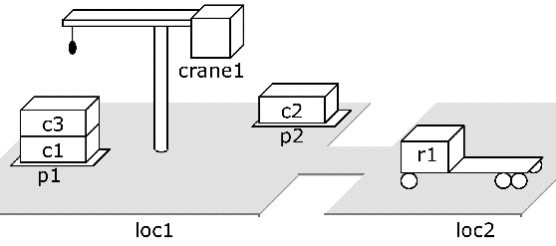
Forward Search
take c3
take c2
…
move r1
…

Slide 3
Properties
Forward-search is sound
  for any plan returned by any of its nondeterministic traces, this plan is guaranteed to be a solution
Forward-search also is complete
  if a solution exists then at least one of Forward-search’s nondeterministic traces will return a solution.

Slide 4
Deterministic Implementations
Some deterministic implementations
of forward search:
  breadth-first search
  depth-first search
  best-first search (e.g., A*)
  greedy search
Breadth-first and best-first search are sound and complete
  But they usually aren’t practical because they require too much memory
  Memory requirement is exponential in the length of the solution
In practice, more likely to use depth-first search or greedy search
  Worst-case memory requirement is linear in the length of the solution
  In general, sound but not complete
    But classical planning has only finitely many states
    Thus, can make depth-first search complete by doing loop-checking
a₁
s₁
a₄
s₄
s₀
s₂
s_{g}
a₂
s₅
a₅
…
a₃
s₃

Slide 5
Branching Factor of Forward Search
a₁
a₂
a₁
a₂
a₃
…
a₅₀
a₃
initial state
goal
Forward search can have a very large branching factor
  E.g., many applicable actions that don’t progress toward goal
Why this is bad:
  Deterministic implementations can waste time trying lots of irrelevant actions
Need a good heuristic function and/or pruning procedure
  See Section 4.5 (Domain-Specific State-Space Planning)
  and Part III (Heuristics and Control Strategies)

Slide 6
Backward Search
For forward search, we started at the initial state and computed state transitions
  new state = γ(s,a)
For backward search, we start at the goal and compute inverse state transitions
  new set of subgoals = γ^{–1}(g,a)
To define γ⁻¹(g,a), must first define relevance:
  An action a is relevant for a goal g if
    a makes at least one of g’s literals true
      g ∩ effects(a) ≠ ∅
    a does not make any of g’s literals false
      g⁺ ∩ effects–(a) = ∅ and g– ∩ effects⁺(a) = ∅

Slide 7
Inverse State Transitions
If a is relevant for g, then
  γ^{–1}(g,a) = (g – effects(a)) ∪ precond(a)
Otherwise γ^{–1}(g,a) is undefined
Example: suppose that
  g = {on(b1,b2), on(b2,b3)}
  a = stack(b1,b2)
What is γ^{–1}(g,a)?

Slide 8
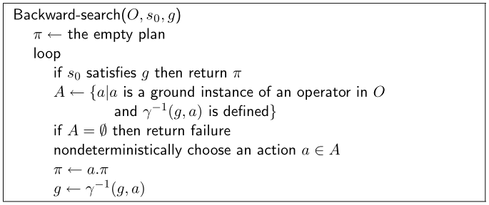
g₁
a₁
g₄
a₄
g₂
g₀
a₂
s₀
a₅
g₅
a₃
g₃

